Slide 1
Design of Communication Systems using MATLAB
Credits: Amit Degada , NIT, Surat.

Slide 2
Simulation “hierarchy”
Event driven simulations:
ns2, Opnet
Networks
Packets, messages, flows
Time driven simulations:
SPW, Cossap, Simulink/Matlab
Links
Waveforms
DSP
Circuits
RF
Technology
Algorithm simulations:
TI CodeComposer
Circuit simulations:
NC-{VHDL/Verilog}, Scirroco,
RF simulations:
PSpice, ADS,XFDTD

Slide 3
Why MATLAB for communication systems design ?
Communications systems can be easily modeled through MATLAB and Simulink
MATLAB has a large library to facilitate signal processing, including powerful tools to visualize signals
MATLAB is easy to learn and great for pedagogical purpose
Notes:
Block-based packages, such as Simulink are not recommended in this course
Student can implement concepts and theories learned from the course easily into MATLAB codes.

Slide 4
Studying Components of Communication system
We will See for two Types:
Analog Communications
Digital Communications

Slide 5
Analog Communication System
This may be any analog signal such as Sine wave, Cosine Wave, Triangle Wave………………..

Slide 6
Analog Modulation/Demodulation Functions
ammod Amplitude modulation
amdemod Amplitude demodulation
fmmod Frequency modulation
fmdemod Frequency demodulation
pmmod Phase modulation
pmdemod Phase demodulation
ssbmod Single sideband amplitude Mod
ssbdemod Single sideband amplitude DeMod

Slide 7
ammod Amplitude modulation
Syntax
y = ammod(x,Fc,Fs)
y = ammod(x,Fc,Fs,ini_phase)
y = ammod(x,Fc,Fs,ini_phase,carramp)
Where
x = Analog Signal
Fc = Carrier Signal
Fs = Sampling Frequency
ini_phase = Initial phase of the Carrier
carramp = Carrier Amplitude

Slide 8
amdemod Amplitude Demodulation
Syntax
z = amdemod(y,Fc,Fs)
z = amdemod(y,Fc,Fs,ini_phase)
z = amdemod(y,Fc,Fs,ini_phase,carramp)
z = amdemod(y,Fc,Fs,ini_phase,carramp,num,den)
Where
y= Received Analog Signal
Fc = Carrier Signal
Fs = Sampling Frequency
ini_phase = Initial phase of the Carrier
carramp = Carrier Amplitude
num, den = Coefficients of butterworth low pass filter

Slide 9
Example……..
Amplitude Modulation Generation
Fs = 8000; % Sampling rate is 8000 samples per second.
Fc = 300; % Carrier frequency in Hz
t = [0:.1*Fs]'/Fs; % Sampling times for .1 second
x = sin(20*pi*t); % Representation of the signal
y = ammod(x,Fc,Fs); % Modulate x to produce y.
figure;
subplot(2,1,1); plot(t,x); % Plot x on top.
subplot(2,1,2); plot(t,y) % Plot y below.

Slide 10
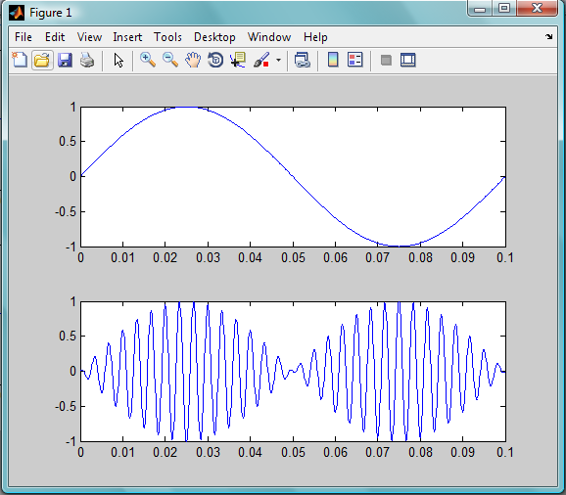
Results

Slide 11
fmmod Frequency modulation
Syntax
y = fmmod(x,Fc,Fs,freqdev)
y = fmmod(x,Fc,Fs,freqdev,ini_phase)
Where
x = Analog Signal
Fc = Carrier Signal
Fs = Sampling Frequency
ini_phase = Initial phase of the Carrier
freqdev = Frequency deviation constant (Hz)

Slide 12
fmdemod Frequency Demodulation
Syntax
z = fmdemod(y,Fc,Fs,freqdev)
z = fmdemod(y,Fc,Fs,freqdev,ini_phase)
Where
Z = Received Analog Signal
Fc = Carrier Signal
Fs = Sampling Frequency
ini_phase = Initial phase of the Carrier
freqdev = Frequency deviation constant (Hz)

Slide 13
pmmod phase modulation
Syntax
y = pmmod(x,Fc,Fs,phasedev)
y = pmmod(x,Fc,Fs,phasedev,ini_phase)
Where
x = Analog Signal
Fc = Carrier Signal
Fs = Sampling Frequency
ini_phase = Initial phase of the Carrier
phasedev = Frequency deviation constant (Hz)

Slide 14
pmdemod phase Demodulation
Syntax
z = pmdemod(y,Fc,Fs,phasedev)
z = pmdemod(y,Fc,Fs,phasedev,ini_phase))
Where
x = Analog Signal
Fc = Carrier Signal
Fs = Sampling Frequency
ini_phase = Initial phase of the Carrier
phasedev = Frequency deviation constant (Hz)

Slide 15
Example
Statement: The example samples an analog signal and modulates it. Then it simulates an additive white Gaussian noise (AWGN) channel, demodulates the received signal, and plots the original and demodulated signals.

Slide 16
Example
% Prepare to sample a signal for two seconds,
% at a rate of 100 samples per second.
Fs = 100; % Sampling rate
t = [0:2*Fs+1]'/Fs; % Time points for sampling
% Create the signal, a sum of sinusoids.
x = sin(2*pi*t) + sin(4*pi*t);
Fc = 10; % Carrier frequency in modulation
phasedev = pi/2; % Phase deviation for phase modulation
y = pmmod(x,Fc,Fs,phasedev); % Modulate.
y = awgn(y,10,'measured',103); % Add noise.
z = pmdemod(y,Fc,Fs,phasedev); % Demodulate.
% Plot the original and recovered signals.
figure; plot(t,x,'k-',t,z,'g-');
legend('Original signal','Recovered signal');

Slide 17
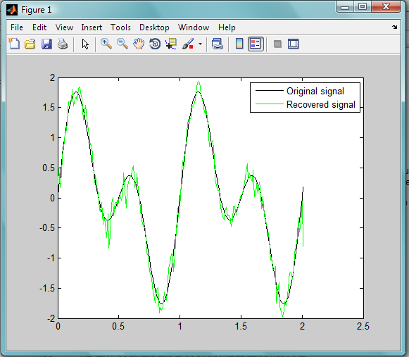
Results
Fig: Phase modulation and demodulation

Slide 18
Digital Communication

Slide 19
Source
randint Generate matrix of Uniformly distributed Random integers
randsrc Generate random matrix using prescribed alphabet
randerr Generate bit error patterns

Slide 20
randint Random Integer
Syntax
out = randint %generates a random scalar that is either 0 or 1, with equal probability
out = randint(m) %generates an m-by-m binary matrix, each of whose entries independently takes the value 0 with probability ½
out = randint(m,n) %generates an m-by-n binary matrix, each of whose entries independently takes the value 0 with probability ½

Slide 21
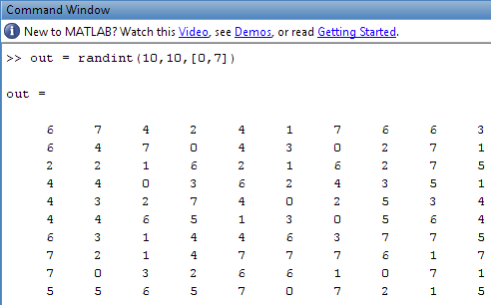
Example
Statement : To generate a 10-by-10 matrix whose elements are uniformly distributed in the range from 0 to 7
out = randint(10,10,[0,7]) or out = randint(10,10,8);
Results

Slide 22
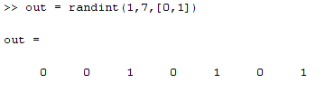
Example
Statement : How to generate 0s and1s….
out = randint(1,7,[0,1])
Results

Slide 23
Digital Communication

Slide 24
Digital Modulation/Demodulation
fskmod Frequency shift keying modulation
fskdemod Frequency shift keying demodulation
pskmod Phase shift keying modulation
pskdemod Phase shift keying demodulation
mskmod Minimum shift keying modulation
mskdemod Minimum shift keying demodulation
qammod Quadrature amplitude modulation
qamdemod Quadrature amplitude demodulation

Slide 25
fskmod
Frequency shift keying modulation
Syntax
y = fskmod(x,M,freq_sep,nsamp)
M is the alphabet size and must be an integer power of 2. The message signal must consist of integers between 0 and M-1.
freq_sep is the desired separation between successive frequencies in Hz.
nsamp denotes the number of samples per symbol in y and must be a positive integer greater than 1.
y = fskmod(x,M,freq_sep,nsamp,Fs)
%Specifies the sampling rate in Hertz
y = fskmod(x,M,freq_sep,nsamp,Fs,phase_cont)
%specifies the phase continuity. Set phase_cont to 'cont' to force phase continuity across symbol boundaries in y, or 'discont' to avoid forcing phase continuity. The default is 'cont'.

Slide 26
fskdemod
Frequency shift keying demodulation
Syntax
z = fskdemod(y,M,freq_sep,nsamp)
M is the alphabet size and must be an integer power of 2.
freq_sep is the frequency separation between successive frequencies in Hz.
nsamp is the required number of samples per symbol and must be a positive integer greater than 1.
z = fskdemod(y,M,freq_sep,nsamp,Fs)
%specifies the sampling frequency in Hz.
z = fskdemod(y,M,freq_sep,nsamp,Fs,symbol_order)
%specifies how the function assigns binary words to corresponding integers. If symbol_order is set to 'bin' (default), the function uses a natural binary-coded ordering. If symbol_order is set to 'gray', it uses a Gray-coded ordering.

Slide 27
Example………
Statement: FSK modulation and demodulation over an AWGN channel
M = 2; k = log2(M);
EbNo = 5;
Fs = 16; nsamp = 17; freqsep = 8;
msg = randint(5000,1,M); % Random signal
txsig = fskmod(msg,M,freqsep,nsamp,Fs); % Modulate.
msg_rx = awgn(txsig,EbNo+10*log10(k)-10*log10(nsamp),...
'measured',[],'dB'); % AWGN channel
msg_rrx = fskdemod(msg_rx,M,freqsep,nsamp,Fs); % Demodulate
[num,BER] = biterr(msg,msg_rrx) % Bit error rate
BER_theory = berawgn(EbNo,'fsk',M,'noncoherent') % Theoretical BER

Slide 28
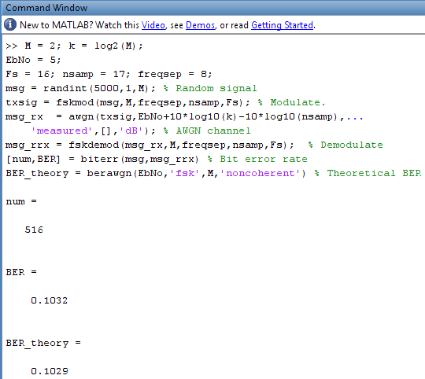
Results

Slide 29
Digital Communication

Slide 30
Pulse shaping
rectpulse Rectangular pulse shaping
rcosflt Filter input signal using raised cosine filter
rcosine Design raised cosine filter

Slide 31
rectpulse
Rectangular pulse shaping
Syntax
y = rectpulse(x,nsamp)
% Applies rectangular pulse shaping to x to produce an output signal having nsamp samples per symbol

Slide 32
Digital Communication

Slide 33
Channels
awgn Add white Gaussian noise to signal
rayleighchan Construct Rayleigh fading channel object
ricianchan Construct Rician fading channel object
bsc Model binary symmetric channel
doppler Package of Doppler classes
doppler.ajakes Construct asymmetrical Doppler spectrum object
doppler.bigaussian Construct bi-Gaussian Doppler spectrum object
doppler.flat Construct flat Doppler spectrum object
And many More……………………….

Slide 34
Digital Communication
Bit Error Rate
Scatter Plot
Eye Diagram

Slide 35
biterr
Compute number of bit errors and bit error rate (BER)
Syntax
[number,ratio] = biterr(x,y)
compares the elements in x and y
The sizes of x and y determine which elements are compared:
    If x and y are matrices of the same dimensions, then biterr compares x and y element by element. number is a scalar. See schematic (a) in the preceding figure.
    If one is a row (respectively, column) vector and the other is a two-dimensional matrix, then biterr compares the vector element by element with each row (resp., column) of the matrix. The length of the vector must equal the number of columns (resp., rows) in the matrix. number is a column (resp., row) vector whose mth entry indicates the number of bits that differ when comparing the vector with the m^{th} row (resp., column) of the matrix.

Slide 36
scatterplot
Generate scatter plot
Syntax
scatterplot(x)
scatterplot(x,n)
scatterplot(x) produces a scatter plot for the signal x.
scatterplot(x,n) is the same as the first syntax, except that the function plots every nth value of the signal, starting from the first value. That is, the function decimates x by a factor of n before plotting.

Slide 37
Simulating a Communication Link….Examples
Statement: Process a binary data stream using a communication system that consists of a baseband modulator, channel, and demodulator. Compute the system's bit error rate (BER). Also, display the transmitted and received signals in a scatter plot. Consider 16 QAM system.

Slide 38
Functions for Tasks
Task
Functions
Generate a random binary data stream
randint
Modulate using 16-QAM
modulate method on modem.qammod object
Add white Gaussian noise
awgn
Create a scatter plot
scatterplot
Demodulate using 16-QAM
modulate method on modem.qamdemod object
Compute the system's BER
biterr

Slide 39
Solution of the problem
Type
>> edit commdoc_mod in command promt

Slide 40
Task 1 Generate binary data
%% Setup
% Define parameters.
M = 16; % Size of signal constellation
k = log2(M); % Number of bits per symbol
n = 3e4; % Number of bits to process
nsamp = 1; % Oversampling rate
%% Signal Source
% Create a binary data stream as a column vector.
x = randint(n,1); % Random binary data stream
% Plot first 40 bits in a stem plot.
stem(x(1:40),'filled');
title('Random Bits');
xlabel('Bit Index'); ylabel('Binary Value');

Slide 41
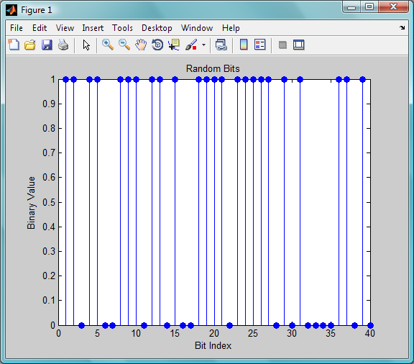
Results
Fig: Binary Data

Slide 42
Task 2 Prepare to Modulate.
%% Bit-to-Symbol Mapping
% Convert the bits in x into k-bit symbols.
xsym = bi2de(reshape(x,k,length(x)/k).','left-msb');
%% Stem Plot of Symbols
% Plot first 10 symbols in a stem plot.
figure; % Create new figure window.
stem(xsym(1:10));
title('Random Symbols');
xlabel('Symbol Index'); ylabel('Integer Value');

Slide 43
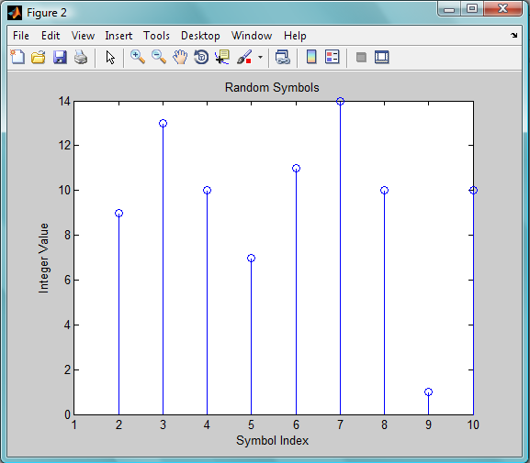
Results
Fig Symbol Index

Slide 44
Task 3 Modulate Using 16-QAM
%% Modulation
y = modulate(modem.qammod(M),xsym); % Modulate using 16- %QAM

Slide 45
Task 4 Add White Gaussian Noise
%% Transmitted Signal
ytx = y;
%% Channel
% Send signal over an AWGN channel.
EbNo = 10; % In dB
snr = EbNo + 10*log10(k) - 10*log10(nsamp);
ynoisy = awgn(ytx,snr,'measured');
%% Received Signal
yrx = ynoisy;

Slide 46
Task 5 Create a Scatter Plot.
%% Scatter Plot
% Create scatter plot of noisy signal and transmitted
% signal on the same axes.
h = scatterplot(yrx(1:nsamp*5e3),nsamp,0,'g.');
hold on;
scatterplot(ytx(1:5e3),1,0,'k*',h);
title('Received Signal');
legend('Received Signal','Signal Constellation');
axis([-5 5 -5 5]); % Set axis ranges.
hold off;

Slide 47
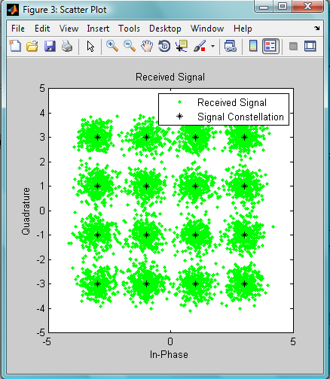
Results
Fig: Scatter Plot

Slide 48
Task 6
Demodulate Using 16-QAM
%% Demodulation
% Demodulate signal using 16-QAM.
zsym = demodulate(modem.qamdemod(M),yrx);

Slide 49
Task 7 Convert the Integer-Valued Signal to a Binary Signal
%% Symbol-to-Bit Mapping
% Undo the bit-to-symbol mapping performed earlier.
z = de2bi(zsym,'left-msb'); % Convert integers to bits.
% Convert z from a matrix to a vector.
z = reshape(z.',prod(size(z)),1);

Slide 50
Task 8 Compute the System's BER
%% BER Computation
% Compare x and z to obtain the number of errors and
% the bit error rate.
[number_of_errors,bit_error_rate] = biterr(x,z)

Slide 51
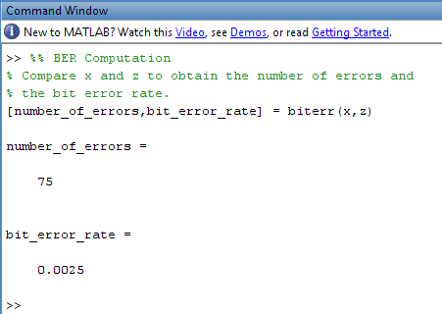
Results

Slide 52
Simulating a Communication Link
Statement: Plot a 16-QAM signal constellation with annotations that indicate the mapping from integers to constellation points.

Slide 53
Solution of the problem
Type
>> edit commdoc_const in command promt

Slide 54
Task 1 Find All Points in the 16-QAM Signal Constellation
M = 16; % Number of points in constellation
h=modem.qammod(M); % Modulator object
mapping=h.SymbolMapping; % Symbol mapping vector
pt = h.Constellation; % Vector of all points in %constellation

Slide 55
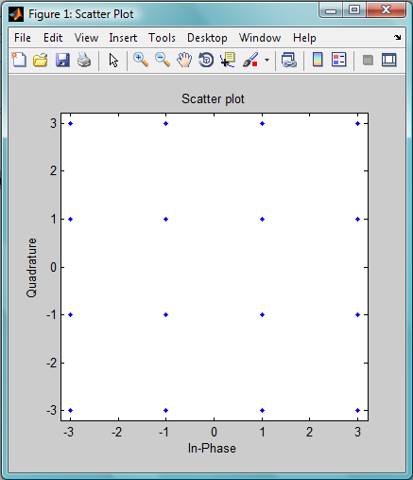
Task 2
Plot the Signal Constellation
% Plot the constellation.
scatterplot(pt);

Slide 56
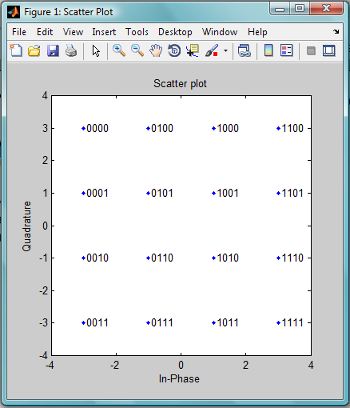
Task 3 Annotate the Plot to Indicate the Mapping
% Include text annotations that number the points.
text(real(pt)+0.1,imag(pt),dec2bin(mapping));
axis([-4 4 -4 4]); % Change axis so all labels fit in plot.
Fig: Binary-Coded 16-QAM Signal Constellation

Slide 57
Modifications…..
%% Modified Plot, With Gray Coding
M = 16; % Number of points in constellation
h = modem.qammod('M',M,'SymbolOrder','Gray'); % Modulator object
mapping = h.SymbolMapping; % Symbol mapping vector
pt = h.Constellation; % Vector of all points in constellation
scatterplot(pt); % Plot the constellation.
% Include text annotations that number the points.
text(real(pt)+0.1,imag(pt),dec2bin(mapping));
axis([-4 4 -4 4]); % Change axis so all labels fit in plot.

Slide 58
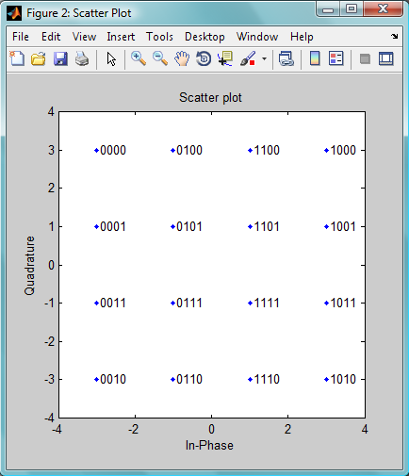
Results

Slide 59
Simulating a Communication Link….Examples Cont
Statement: Modify the Gray-coded modulation example so that it uses a pair of square root raised cosine filters to perform pulse shaping and matched filtering at the transmitter and receiver, respectively.

Slide 60
Solution of the problem
Type
>> edit commdoc_rrc
to view the code

Slide 61
Task1 Define Filter-Related Parameters
nsamp = 4; % Oversampling rate
Also Define
%% Filter Definition
% Define filter-related parameters.
filtorder = 40; % Filter order
delay = filtorder/(nsamp*2); % Group delay (# of %input samples)
rolloff = 0.25; % Rolloff factor of filter

Slide 62
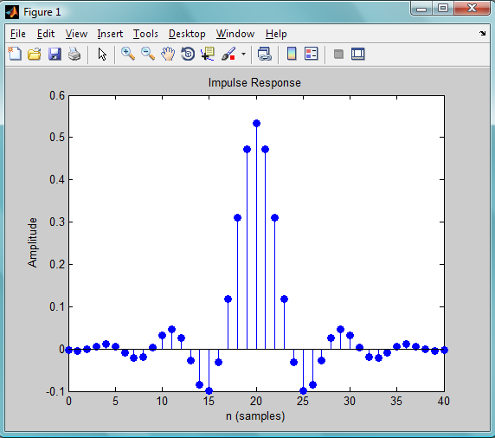
Task 2 Create a Square Root Raised Cosine Filter
% Create a square root raised cosine filter.
rrcfilter = rcosine(1,nsamp,'fir/sqrt',rolloff,delay);
% Plot impulse response.
figure; impz(rrcfilter,1);

Slide 63
Task 3
Filter the Modulated Signal
%% Transmitted Signal
% Upsample and apply square root raised cosine filter.
ytx = rcosflt(y,1,nsamp,'filter',rrcfilter);
% Create eye diagram for part of filtered signal.
eyediagram(ytx(1:2000),nsamp*2);

Slide 64
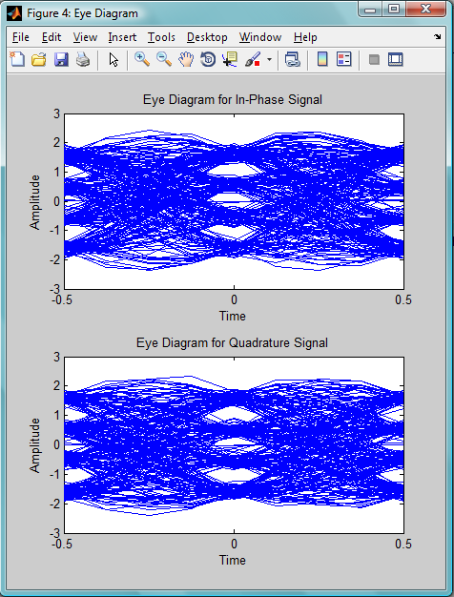
Fig: Eye Diagram

Slide 65
Task 4
Filter the Received Signal
%% Received Signal
% Filter received signal using square root raised cosine filter.
yrx = rcosflt(ynoisy,1,nsamp,'Fs/filter',rrcfilter);
yrx = downsample(yrx,nsamp); % Downsample.
yrx = yrx(2*delay+1:end-2*delay); % Account for delay.

Slide 66
Task 5 Adjust the Scatter Plot
%% Scatter Plot
% Create scatter plot of received signal before and
% after filtering.
h = scatterplot(sqrt(nsamp)*ynoisy(1:nsamp*5e3),nsamp,0,'g.');
hold on;
scatterplot(yrx(1:5e3),1,0,'kx',h);
title('Received Signal, Before and After Filtering');
legend('Before Filtering','After Filtering');
axis([-5 5 -5 5]); % Set axis ranges.

Slide 67
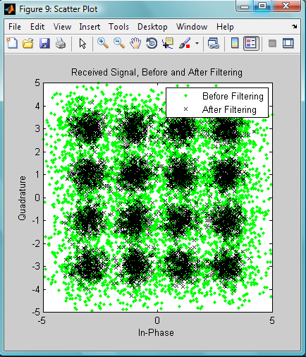
Results
Fig: Scatter Plot

Slide 68
Presentation Outline
Objective of the Lecture
Section Overview
Expected background from the Users
Studying Components of the Communication System
BER : As performance evaluation Technique
Scatter Plot
Simulating a Communication Link….Examples
BERTool : A Bit Error Rate GUI

Slide 69
BERTool : A Bit Error Rate GUI
BERTool is an interactive GUI for analyzing communication systems' bit error rate (BER) performance
Using BERTool you can
    Generate BER data
    Plot one or more BER data sets on a single set of axes
    Fit a curve to a set of simulation data
    Send BER data to the MATLAB workspace or to a file for any further processing you might want to perform

Slide 70
Opening BERTool
To Open the BERTool type
>> bertool
In command prompt

Slide 71
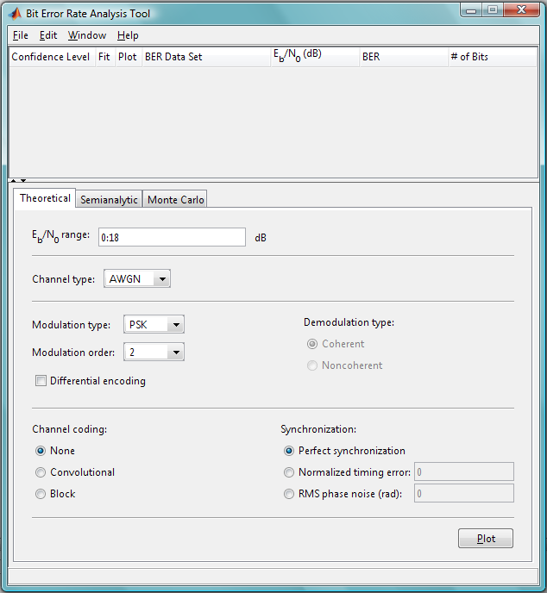
BERTool

Slide 72
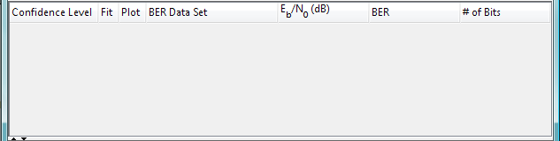
BERTool Environment
A data viewer at the top. It is initially empty

Slide 73
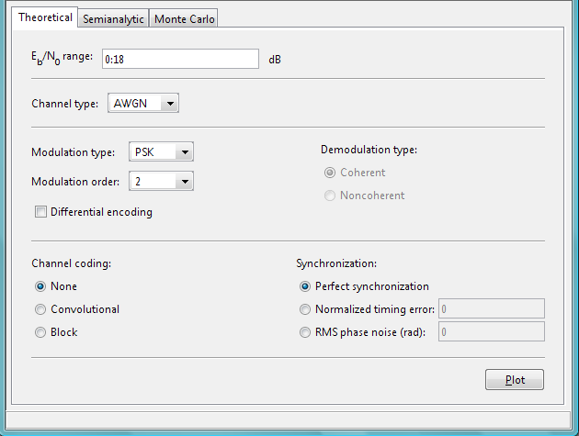
BERTool Environment
A set of tabs on the bottom

Slide 74
Computing Theoretical BERs
1. Open BERTool, and go to the Theoretical tab.
2. Set the parameters to reflect the system whose performance you want to analyze. Some parameters are visible and active only when other parameters have specific values.
3. Click Plot.

Slide 75

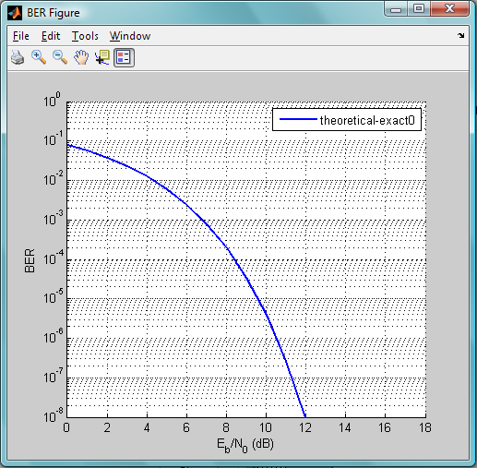
Computing Theoretical BERs

Slide 76

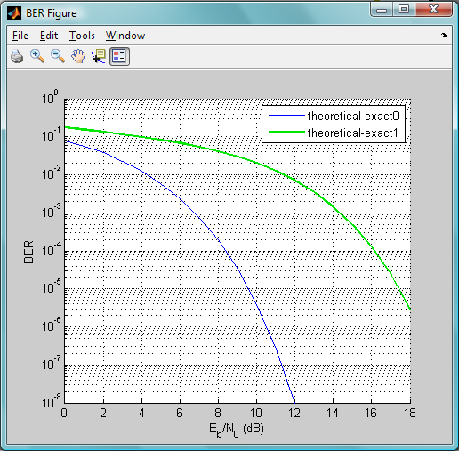
Computing Theoretical BERs
4. Change the Modulation order parameter to 16, and click Plot..

Slide 77
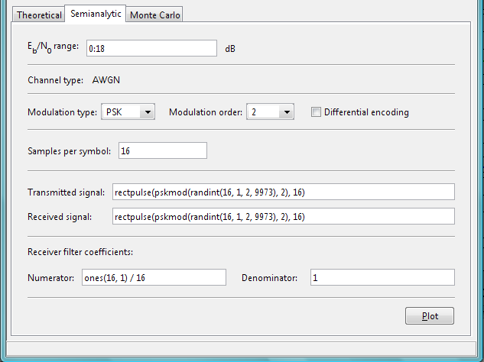
Using the Semianalytic Technique to Compute BERs
To access the semianalytic capabilities of BERTool, open the Semianalytic tab.

Slide 78
Example…..
This example illustrates how BERTool applies the semianalytic technique, using 16-QAM modulation.
Running the Semianalytic Example
Task 1:To set up the transmitted and received signals, run steps 1 through 4 from the code example
% Step 1. Generate message signal of length >= M^L.
M = 16; % Alphabet size of modulation
L = 1; % Length of impulse response of channel
msg = [0:M-1 0]; % M-ary message sequence of length > M^L
% Step 2. Modulate the message signal using baseband modulation.
modsig = qammod(msg,M); % Use 16-QAM.
Nsamp = 16;
modsig = rectpulse(modsig,Nsamp); % Use rectangular pulse shaping.

Slide 79
Example
% Step 3. Apply a transmit filter.
txsig = modsig; % No filter in this example
% Step 4. Run txsig through a noiseless channel.
rxsig = txsig*exp(j*pi/180); % Static phase offset of 1 degree
Task 2: Open BERTool and go to the Semianalytic tab.

Slide 80
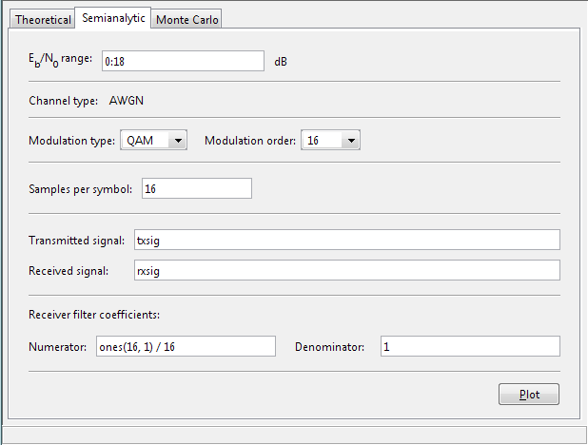
Task 3: Set parameters as shown in the following figure.
Task 4: Click Plot

Slide 81
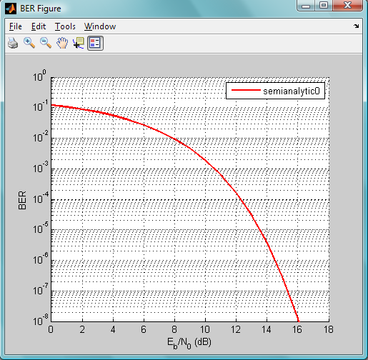

Slide 82

Questions

Slide 83

Thank You

